Slide 1
GPU Architecture meeting 4

Slide 2
Thank you everyone!
Final meeting for the quarter!
Github commits
Testing your modules
Where we’re going
Next steps

Slide 3
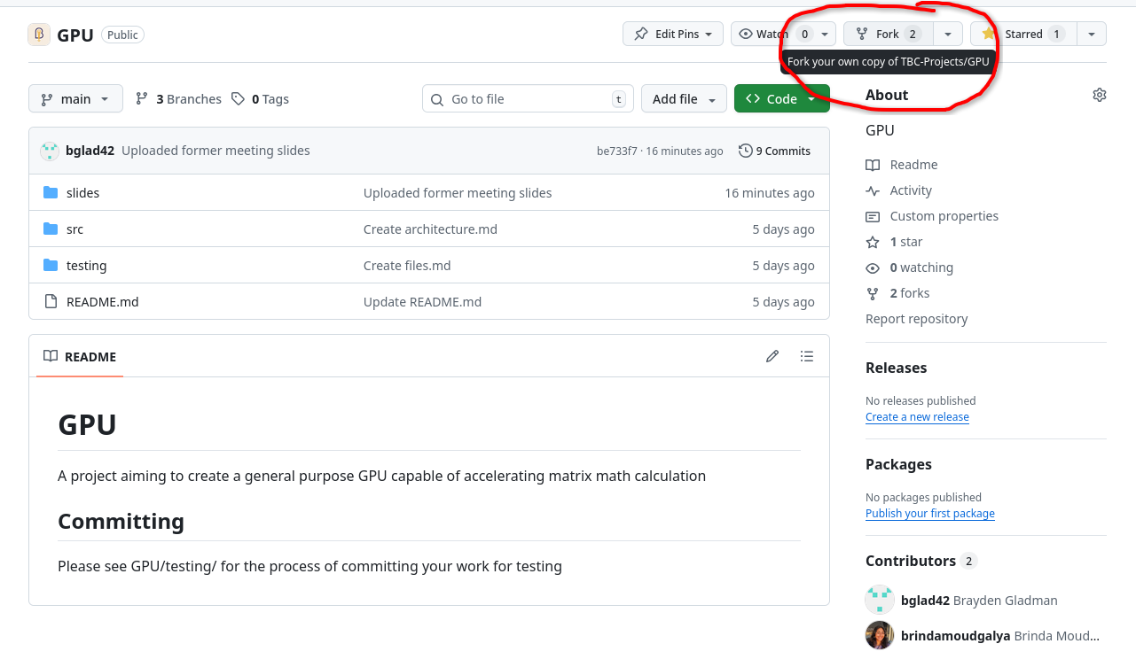
Github
Please do the following
If you haven’t yet, create a GitHub Account
Access the GPU repository
Clone it
https://github.com/TBC-Projects/GPU

Slide 4
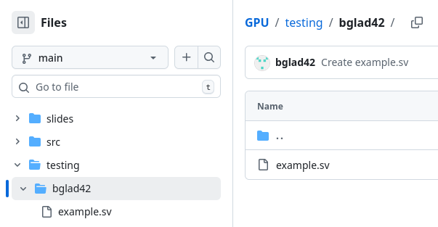
Github
Now I need you to commit any modules you’ve made
Hierarchy should be as follows
Gpu
Testing
[Your Name/netid/username]
[example].sv
[example2].sv
When your changes are made, make a pull request to the main branch!!

Slide 5
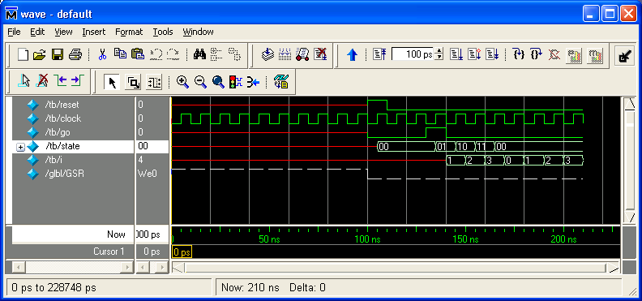
Logic Simulation
So yeah, it’s not immediately obvious if your solution is the correct one, we should test behavior
Simulate the device
Device Under Test
Stimulate the device
Inputs
Read outputs, match to correct

Slide 6
Simulation Demo
Basic test bench
4 to 1 mux

Slide 7
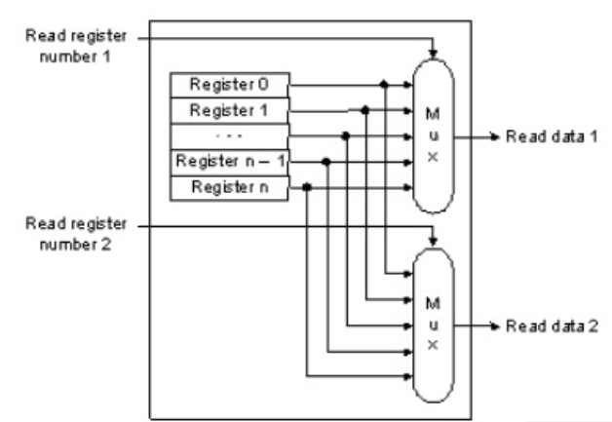
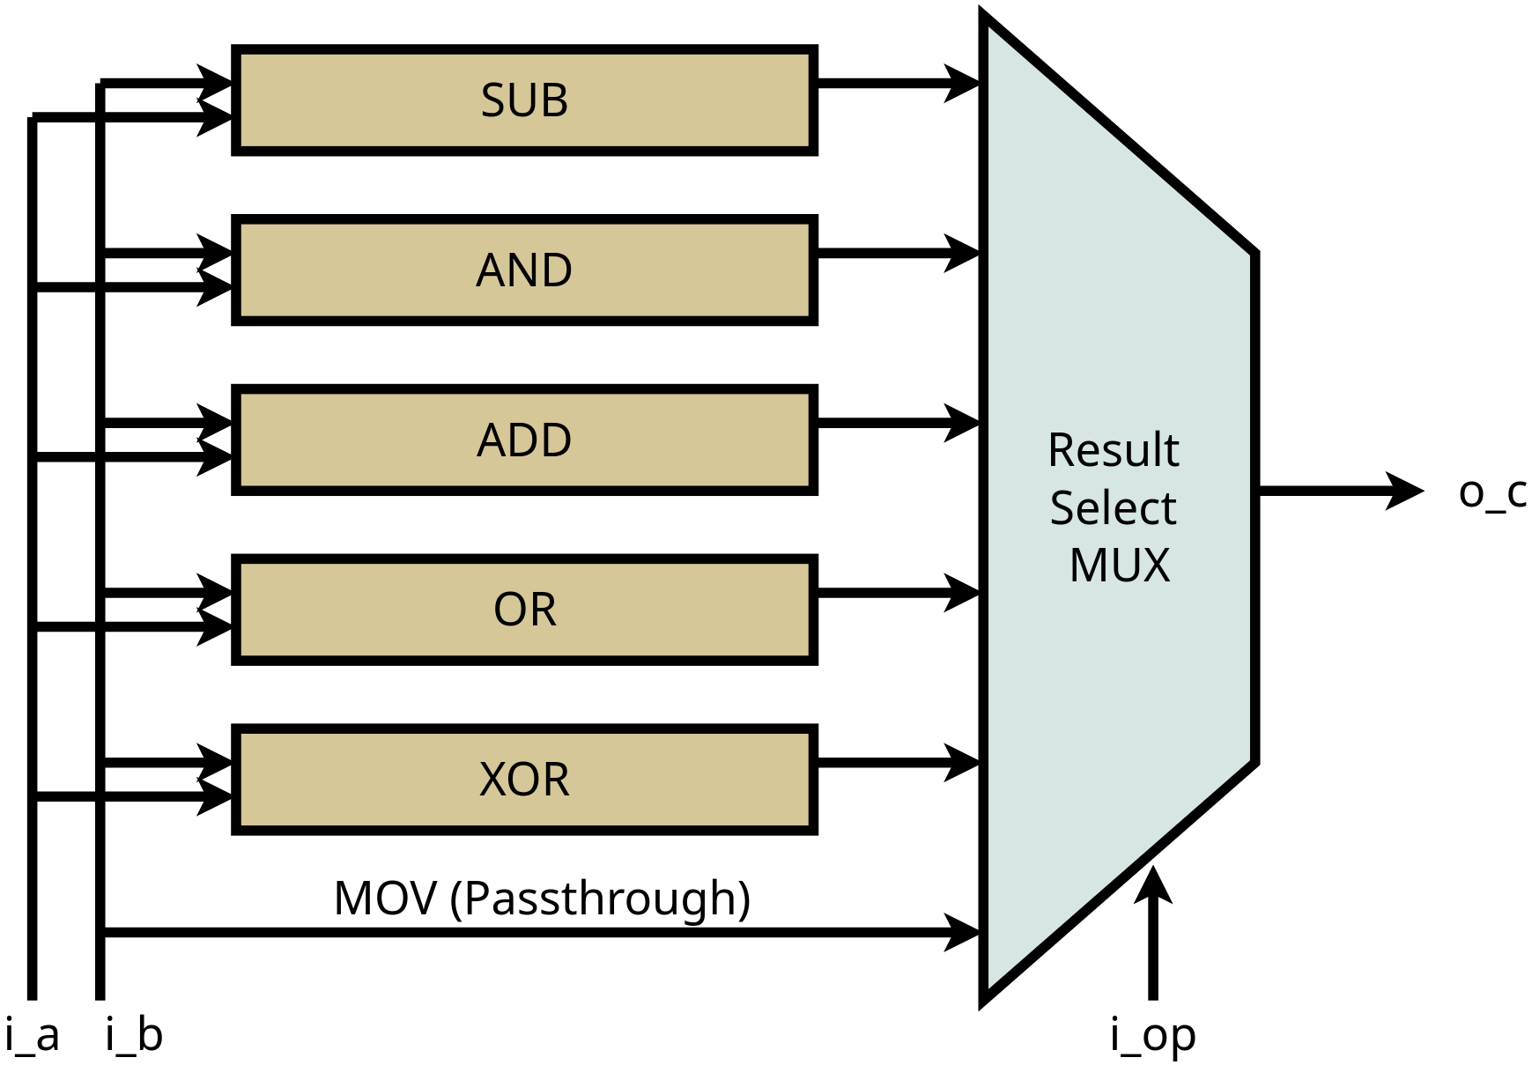
Where this is all going
The Registers look like this, and feed their two outputs to the ALU to do one of its functions

Slide 8
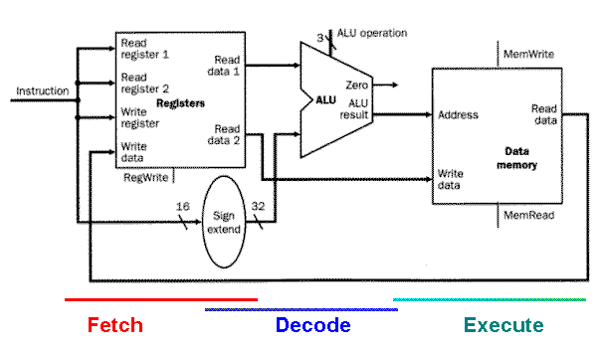
Where this is all going
Once these pieces completed, we put together to make a processor (right now, we are hand waving memory)
Henceforth this = Thread

Slide 9
Where this is all going
So when does this become a gpu?
What if we had a bunch of these?

Slide 10
Where this is all going
Our registers will contain this
X15: Read only identifier
X14: Block dimension
X13: Read only 0
...
X0: General Purpose Register
Identifier (we will need this)
Important for matrices
Zero only (critical for a number of operations)
Rest are for storing the actual values

Slide 11
Where this is all going
Zooming out
X15: Read only identifier
X14: Block dimension
X13: Current Block
...
X0: General Purpose Register
Identifier (we will need this)
Information about current process
Information about current process
Rest are for storing the actual values

Slide 12
Where this is all going
Scheduler
Controls
Thread 0 | Thread 1
Thread 2 | Thread 3
Zooming out further
Scheduler to manage what each thread does
All of this together will be a core
We can go further

Slide 13
Where this is all going
Dispatch
Core 0 | Core 2
Core 2 | Core 3
Zooming out even further
Dispatch breaks up an input kernel into blocks, distributes it to an available core, tracks state of each core

Slide 14
Once again, thank you all!
Next meeting in the spring!

